Slide 1
DATA 403 Final Presentation
Student ID: 2021320322
Name: 윤민서
Notes:
Hello, I'm Yoon Minseo, majoring in data science.

Slide 2
Contents
Introduction
Method
Experiments
Conclusion
Notes:
This is the contents.

Slide 3
Introduction
Environments
Classic control: Pendulum
Mujoco: Hopper, Half Cheetah, Humanoid Standup
Atari: X (no GPU)
Properties
Continuous action space
Humanoid Standup: Unresolved problem! (Version 4)
→ This reason made me choose to solve this problem.
Notes:
I experimented with my code on four environments. All of them have continuous action spaces. And the reason why I chose the humanoid standup environment is that it has not been solved yet. I could not find the success result on version 4.

Slide 4
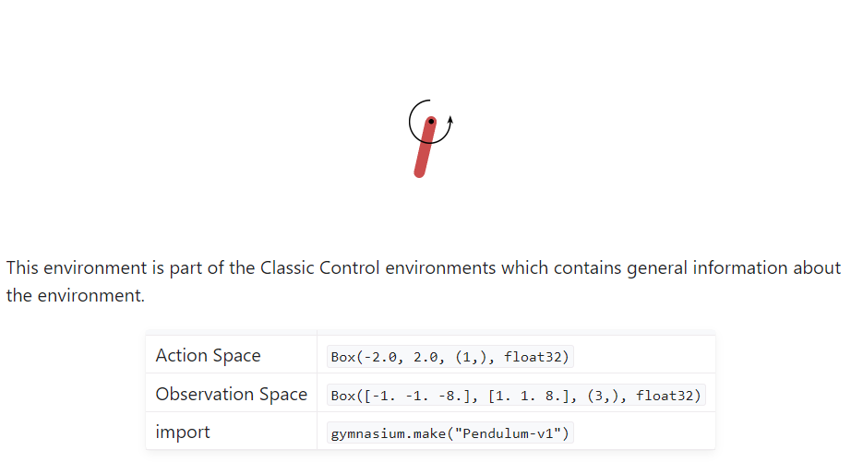
Introduction
Pendulum: swing it into an upright position
reward = -(theta² + 0.1 * theta_dt² + 0.001 * torque²)
Notes:
The goal of a pendulum environment is to swing the pendulum into an upright position. We can apply torque in counterclockwise or clockwise directions as much as we want. And the maximum reward is zero.

Slide 5
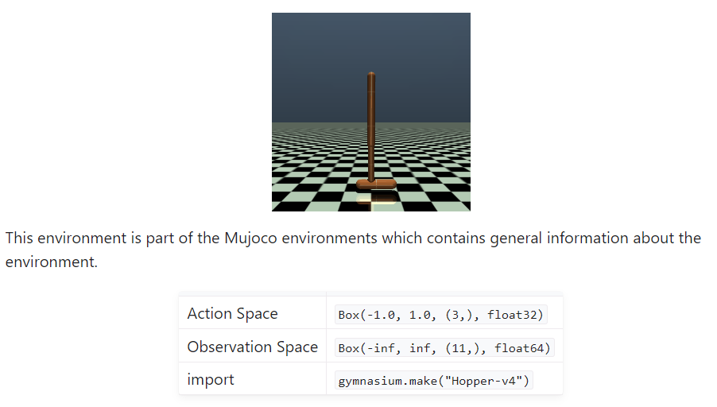
Introduction
Hopper: make hops that move in the forward (right) direction
reward = healthy_reward + forward_reward - ctrl_cost
Notes:
The goal of a hopper environment is to make hops that move in the forward direction. We can apply torques on the three hinges connecting the four body parts.

Slide 6
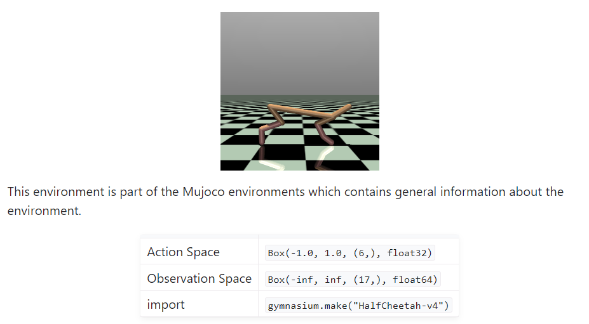
Introduction
Half Cheetah: make the cheetah run forward (right) as fast as possible
reward = forward_reward - ctrl_cost
Notes:
The goal of a half cheetah environment is to make the cheetah run forward as fast as possible. The torque can be applied to the other 6 joints. And its reward does not depend on only speed but also on control cost.

Slide 7
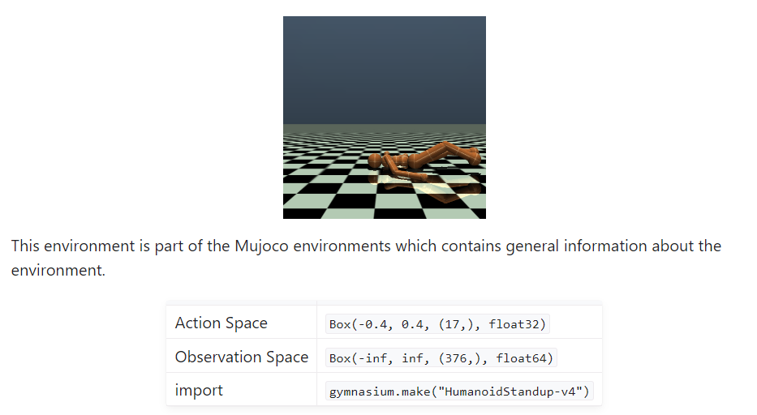
Introduction
Humanoid Standup: make the humanoid standup and then keep it standing
reward = uph_cost + 1 - quad_ctrl_cost - quad_impact_cost
Notes:
The goal of a humanoid standup environment is to make the humanoid standup and then keep it standing. The environment starts with the humanoid laying on the ground. And we can keep it standing by applying torques on the various hinges.

Slide 8
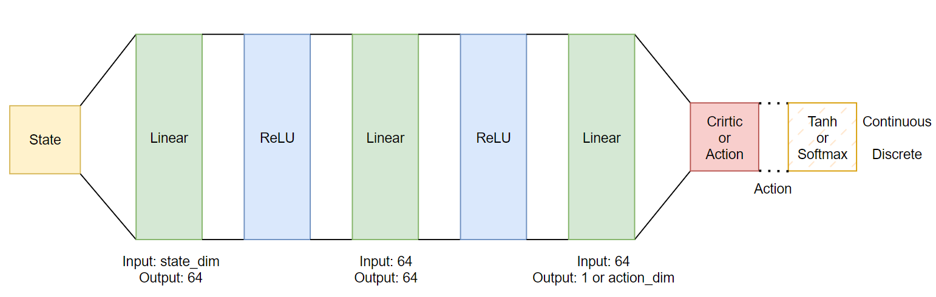
Method
Baseline Deep Learning Architecture - PPO
Notes:
Here is a method. I implemented PPO algorithm with a hidden layer whose dimension is 64. Activation functions are ReLU basically.

Slide 9
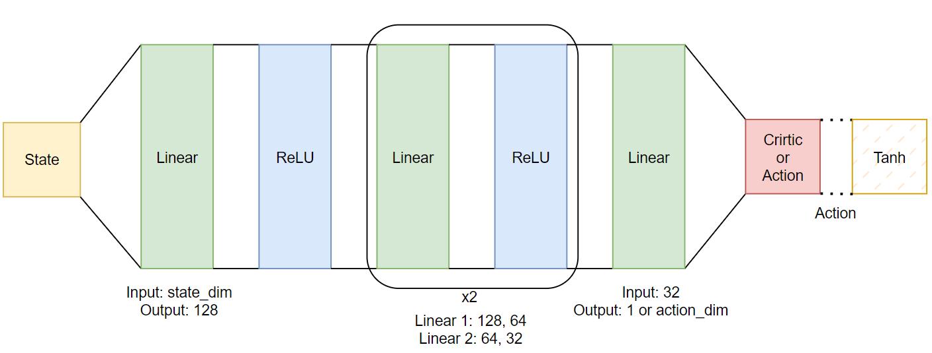
Method
Additional Architecture 1 for Humanoid Standup
Notes:
Also, to try humanoid standup environment, I modified the architecture in various ways. Since the state dimension of the humanoid standup is 376, I thought the hidden dimension of 64 was too small.

Slide 10

Method
Additional Architecture 2 for Humanoid Standup
Notes:
The second additional architecture is one more layer and no hierarchical architecture. That is, this is a denser architecture than the first one.

Slide 11
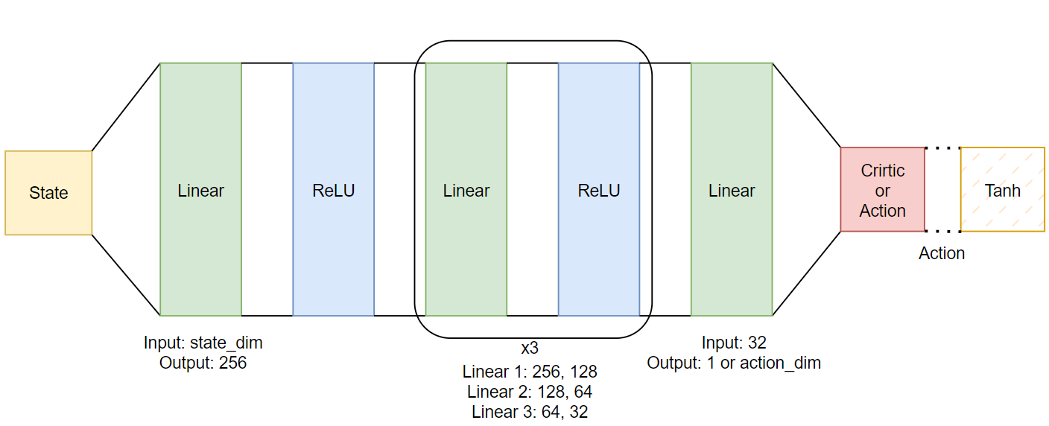
Method
Additional Architecture 3 for Humanoid Standup
Notes:
The third additional architecture is two more layers and hierarchical architecture. As I mentioned, because the state dimension is 376, there is no bottleneck in this architecture.

Slide 12
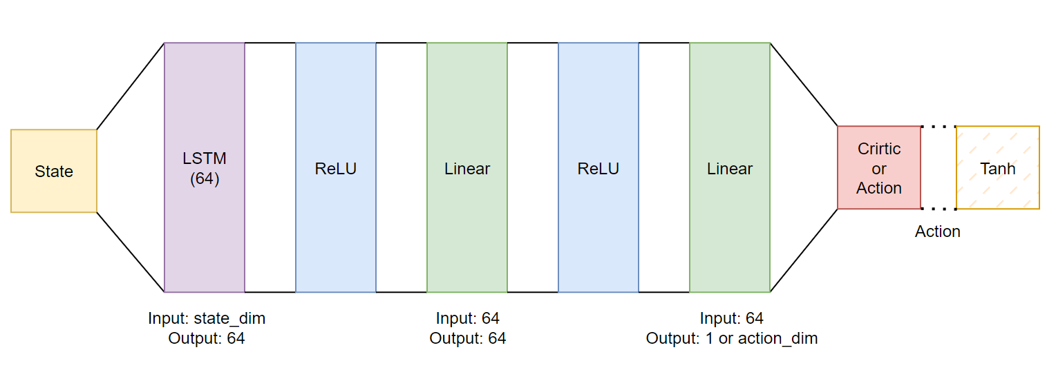
Method
Additional Architecture 4 for Humanoid Standup (Not Good)
Notes:
Since I thought that the process of human standing up was sequential, I applied LSTM to process sequential data, but I did not record the performance due to its poor training performance.

Slide 13
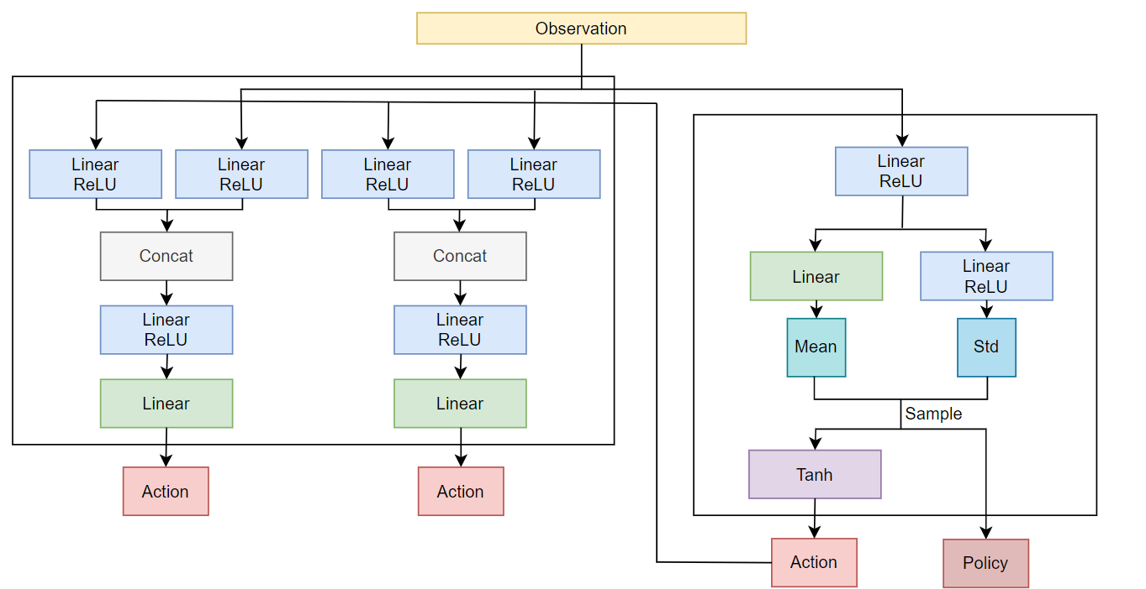
Method
Additional RL Technique - SAC
Notes:
This is an additional RL technique. SAC, an off-policy method, is known to perform better than PPO. There are many variants of SAC, but I conducted experiments using the vanilla arichitectures.

Slide 14
Method
Additional RL Technique
gym.wrappers.FlattenObservation()
gym.wrappers.ClipAction()
gym.wrappers.NormalizeObservation()
gym.wrappers.TransformObservation()
gym.wrappers.NormalizeReward()
gym.wrappers.TransformReward()
These techniques made the training performance much better!
But they caused overfitting, either.
See in experiments part
Training procedure
See in experiments part
Notes:
And I conducted an experiment using these wrappers. As you can see in the experiments section later, the training performance was much better when using wrappers. However, testing performance showed lower-than-expected results.

Slide 15
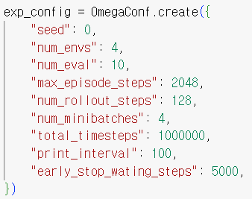
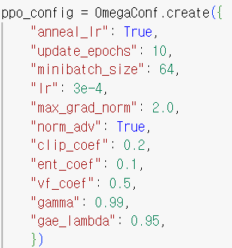
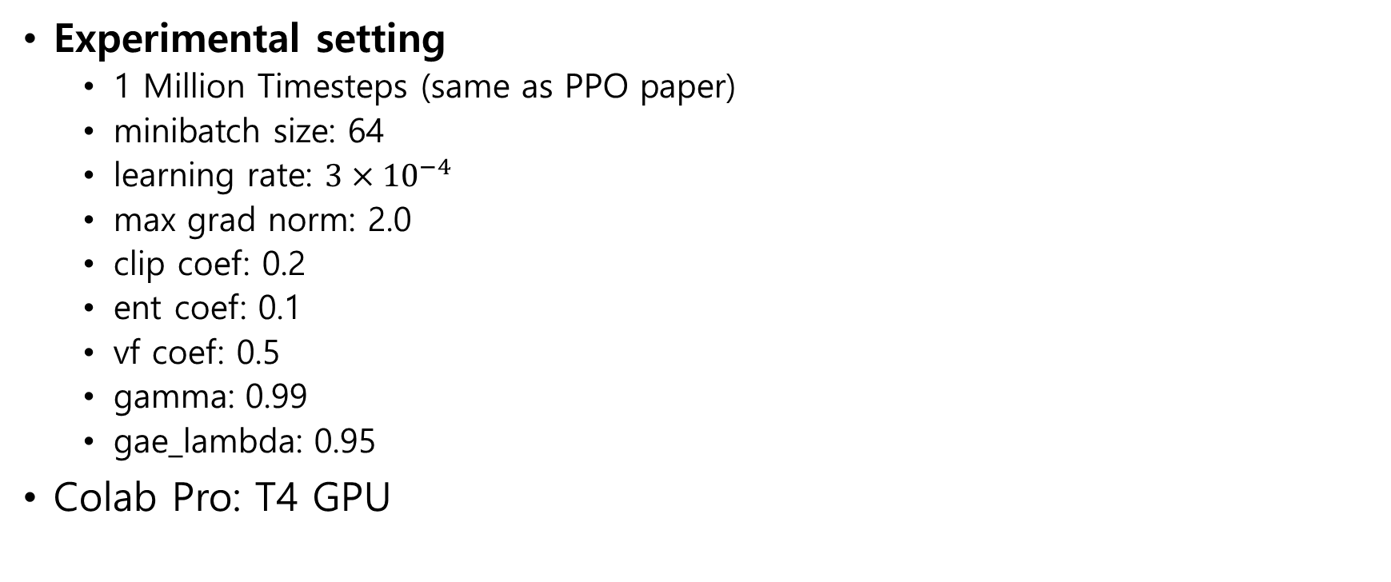
Experiments
Experimental setting
1 Million Timesteps (same as PPO paper)
minibatch size: 64
learning rate: $3×{10}^{−4}$
max grad norm: 2.0
clip coef: 0.2
ent coef: 0.1
vf coef: 0.5
gamma: 0.99
gae_lambda: 0.95
Colab Pro: T4 GPU
Notes:
Hyperparameters were brought from the PPO paper. And I implemented my notebook on colab with T4 GPU.

Slide 16
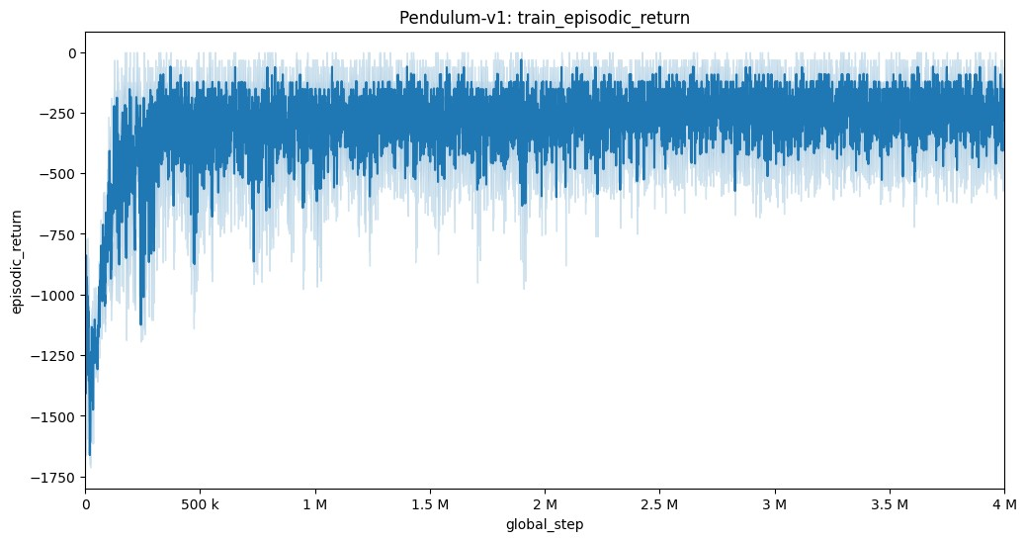
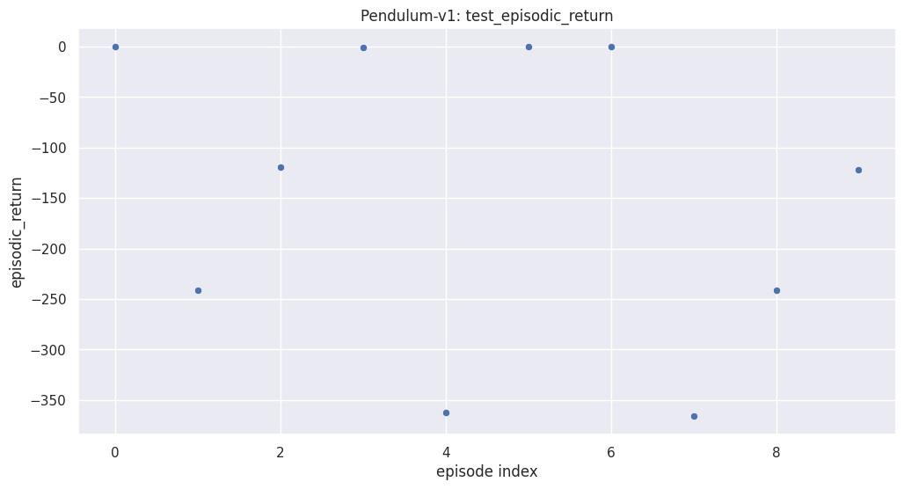
Experiments
Performance – Pendulum
Average of 10 times evaluation: -145.24136
Notes:
This is a pendulum. It is regrettable that it did not converge to zero, but the learning proceeded successfully.

Slide 17
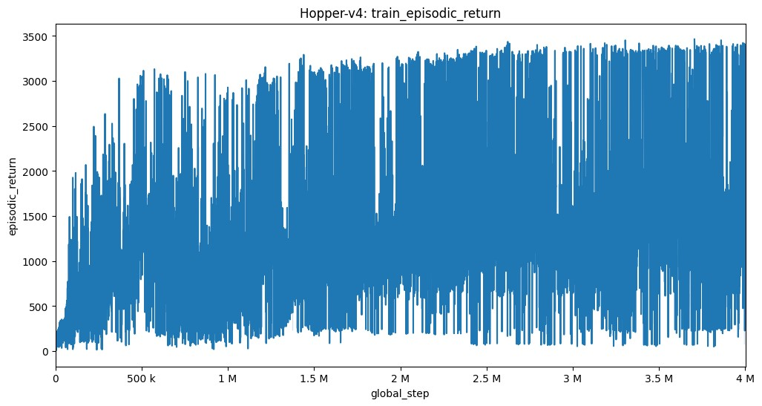
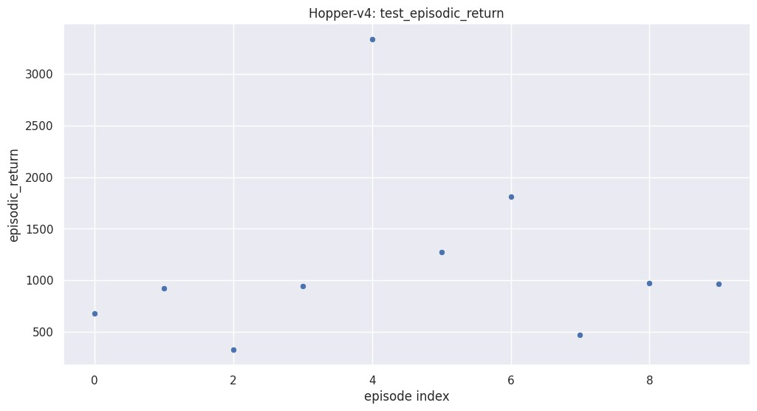
Experiments
Performance – Hopper
Average of 10 times evaluation: 1170.7078
Notes:
This is a hopper. It tends to increase, but the variance seems to be too large. I think It can be solved through hyperparameter tuning, but since it's not my main environment, I stopped after I found that the learning is going well.

Slide 18
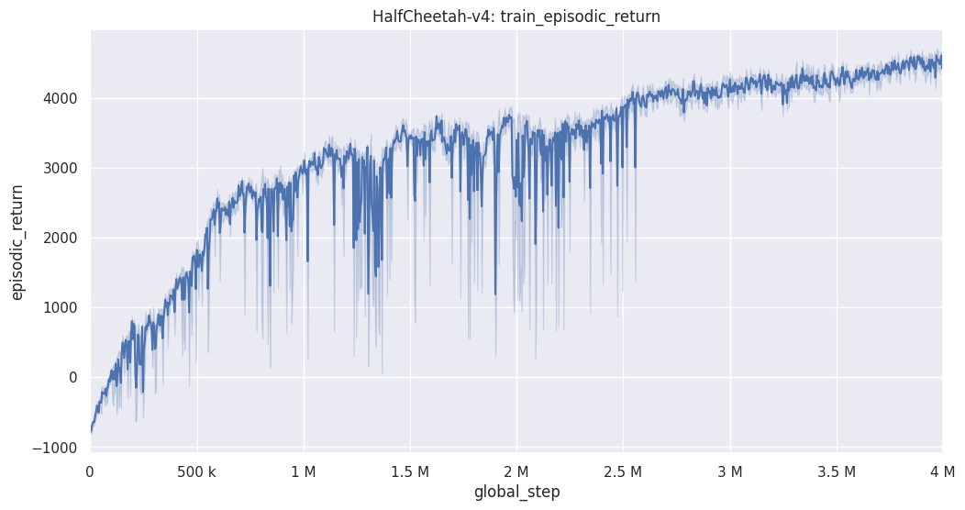
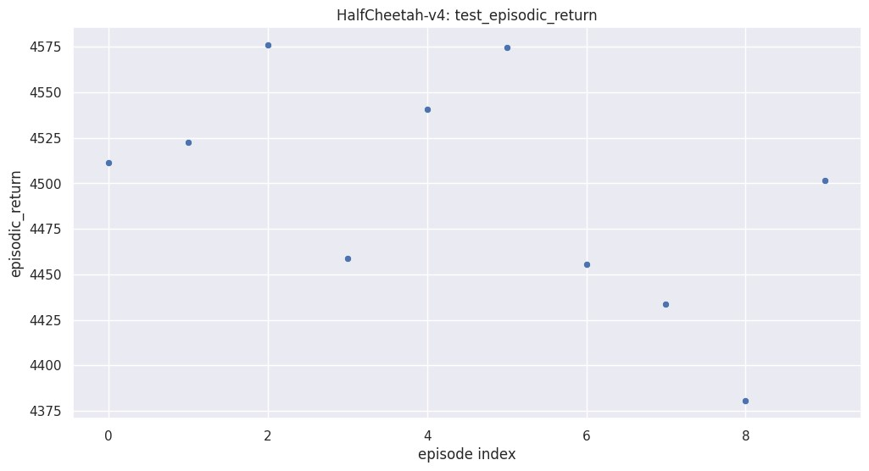
Experiments
Performance – Half Cheetah
Average of 10 times evaluation: 4495.529
Notes:
This is a half cheetah. You can see that the learning has progressed very successfully.

Slide 19
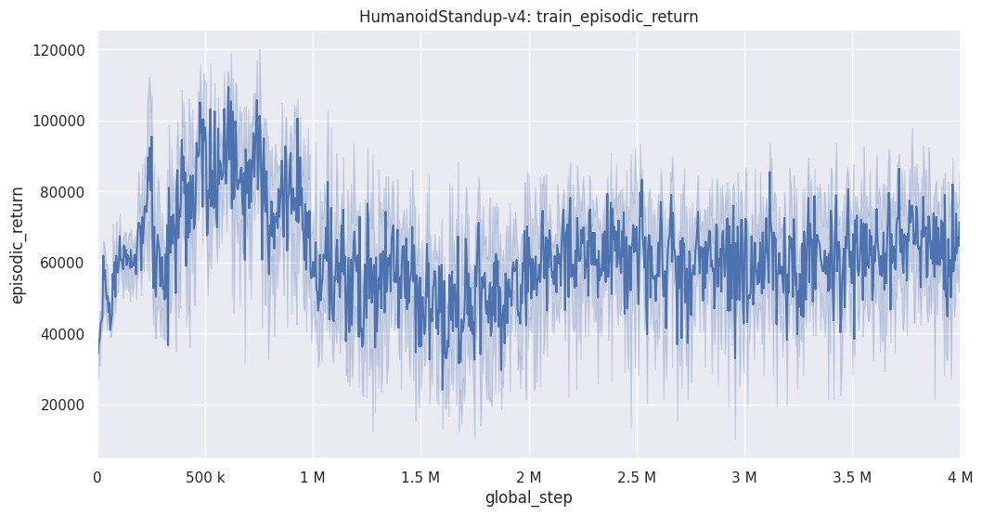
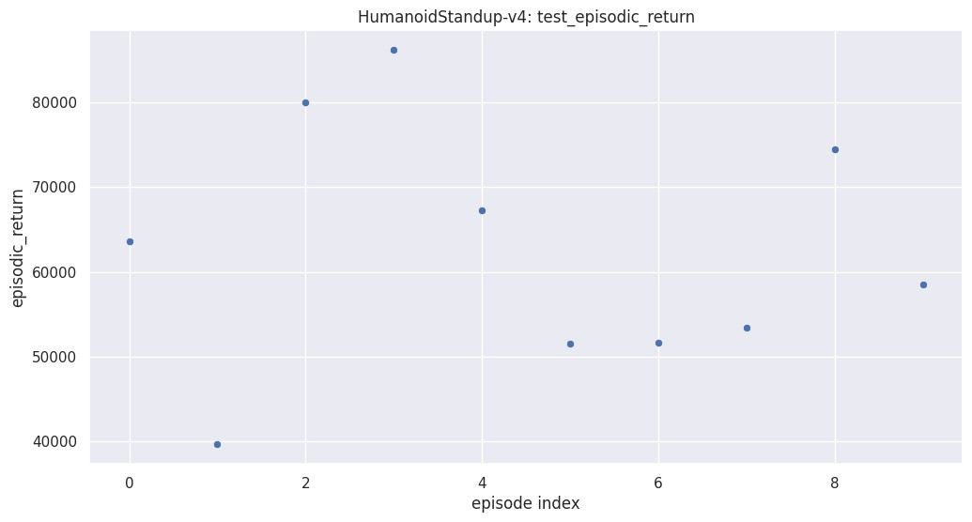
Experiments
Performance 1 – Humanoid Standup
Average of 10 times evaluation: 62612.426
Notes:
This is a humanoid standup. It is a result using baseline architecture.

Slide 20
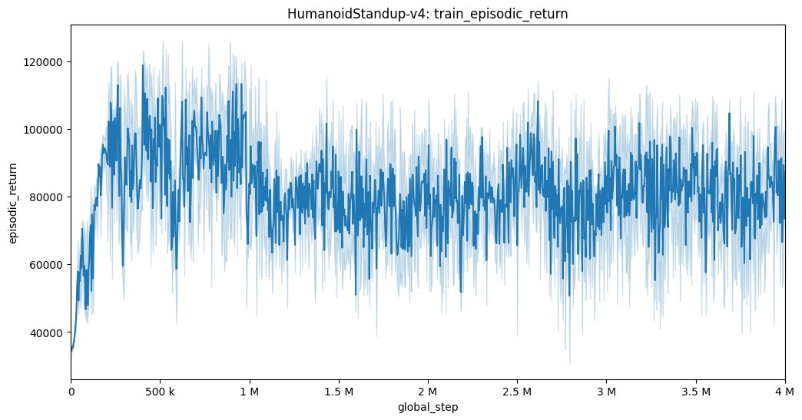
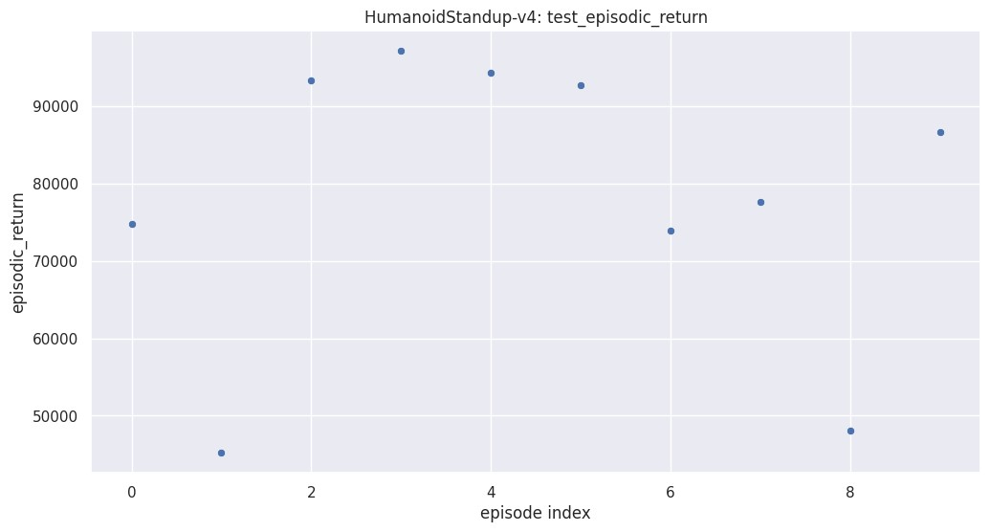
Experiments
Performance 2 – Humanoid Standup
Average of 10 times evaluation: 78353.44
Difference: Additional Architecture 1 (More, hierarchical layers 128 – 64 – 32)
Notes:
It is a result using an additional architecture 1, the performance improved slightly. However, looking at the previous slide and the current slide, you can see that the learning curve is falling after reaching its maximum value at 500 to 600k timesteps.

Slide 21
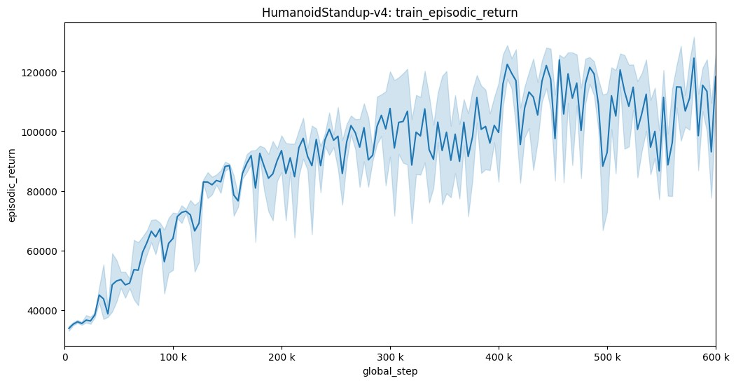
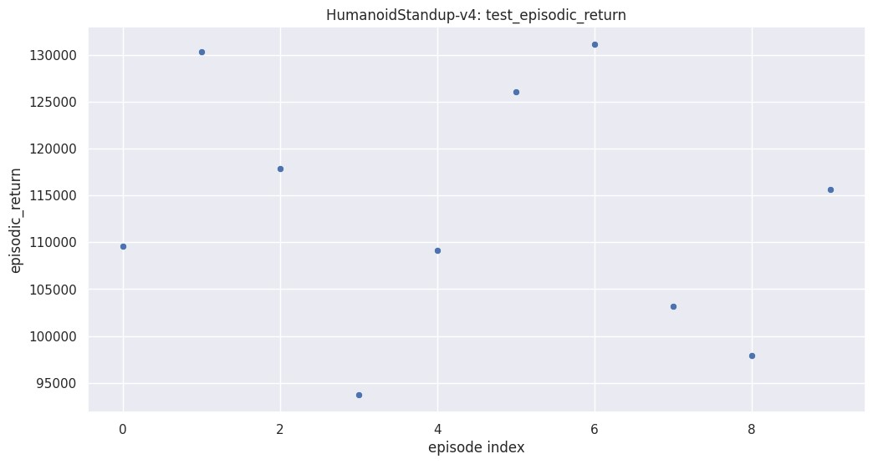
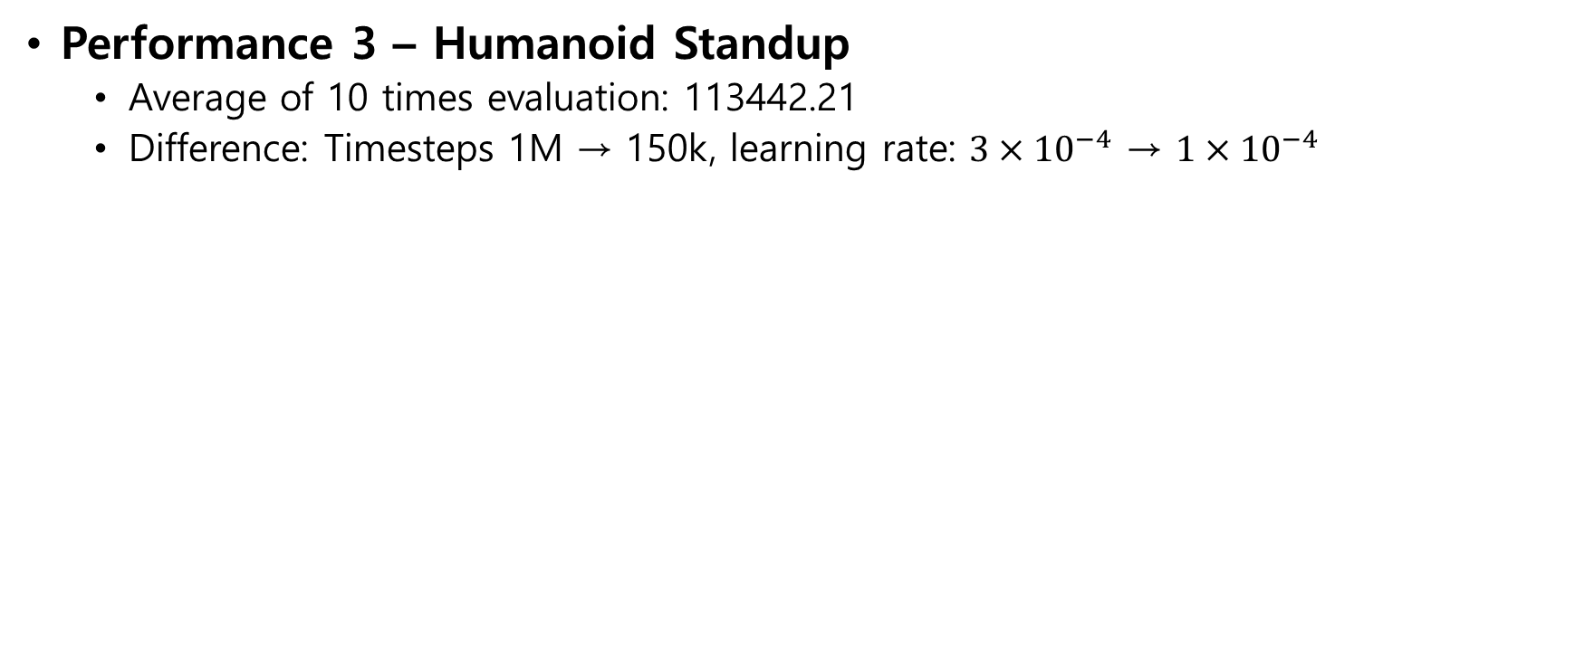
Experiments
Performance 3 – Humanoid Standup
Average of 10 times evaluation: 113442.21
Difference: Timesteps 1M → 150k, learning rate: $3×{10}^{−4}$ → $1×{10}^{−4}$
Notes:
So, after setting the timestep to finish the experiment at 600k, the learning rate was also set slightly smaller, and there was a large performance improvement.

Slide 22
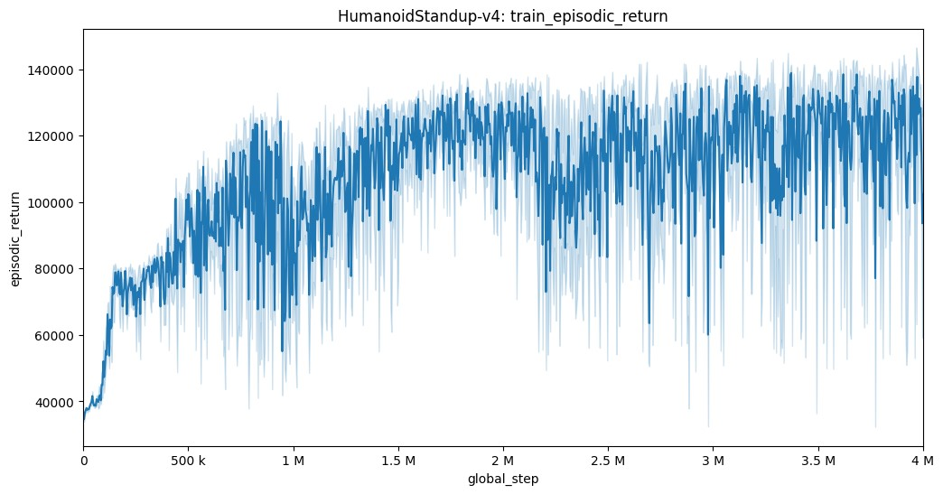
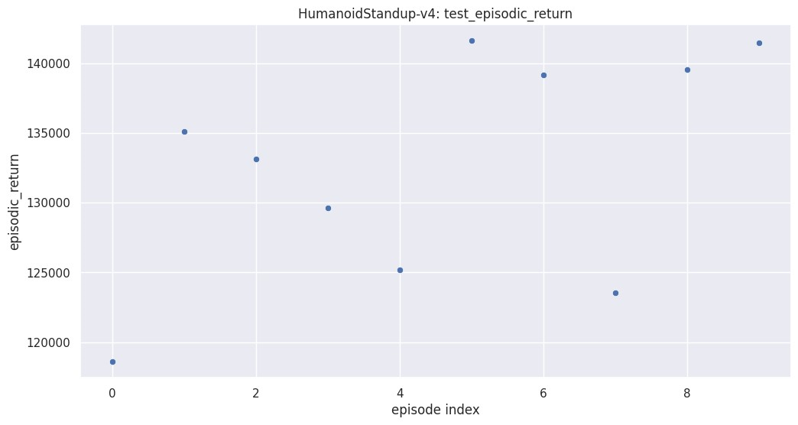
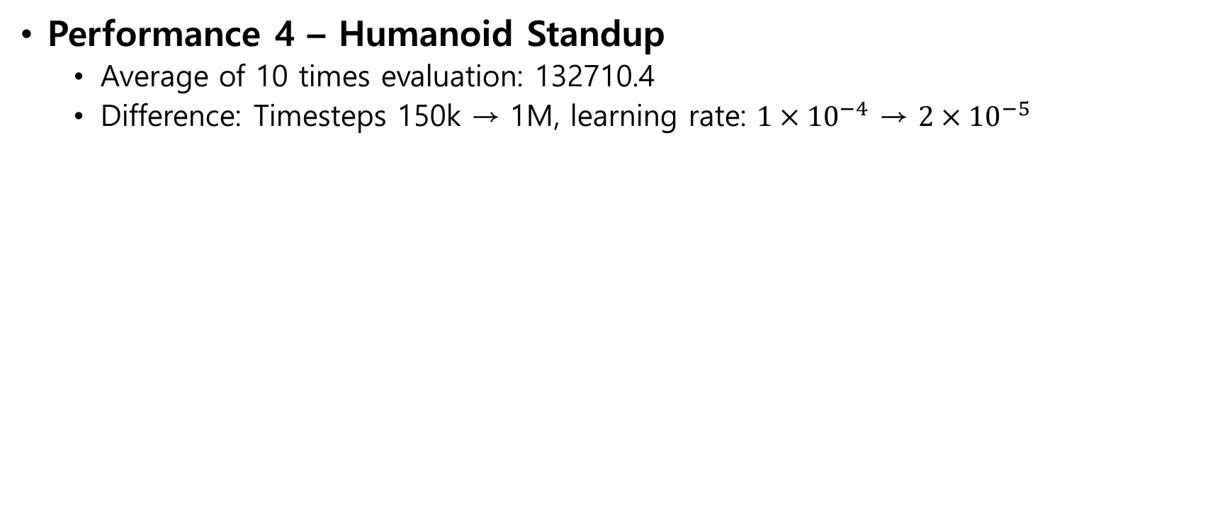
Experiments
Performance 4 – Humanoid Standup
Average of 10 times evaluation: 132710.4
Difference: Timesteps 150k → 1M, learning rate: $1×{10}^{−4}$ → $2×{10}^{−5}$
Notes:
Based on this fact, the performance has been greatly improved by reducing the learning rate to maintain performance while returning the timestep to 1 million. However, since the variance is large,

Slide 23
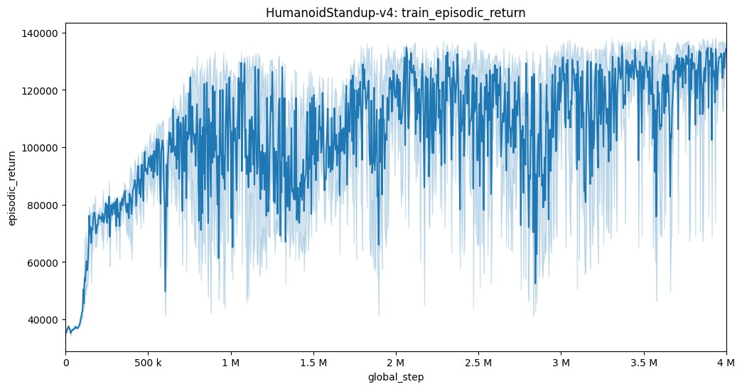
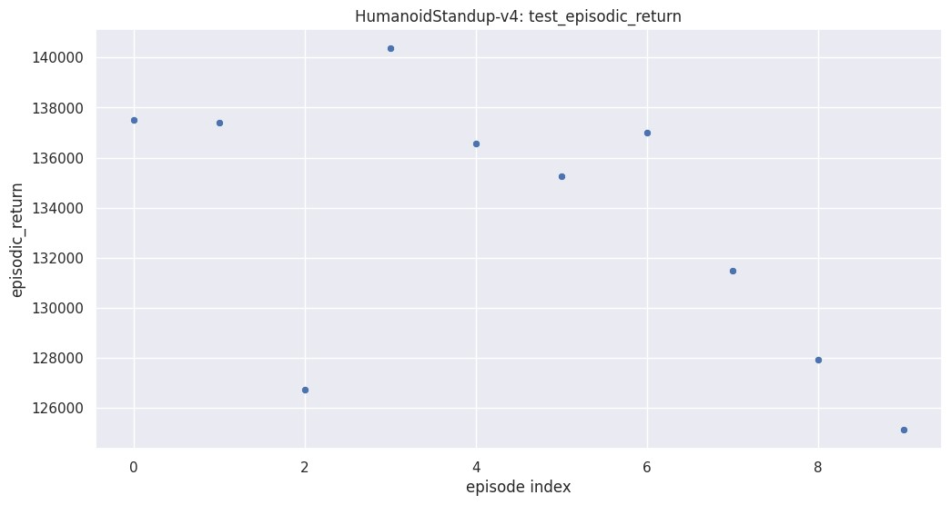
Experiments
Performance 5 – Humanoid Standup
Average of 10 times evaluation: 133542.47
Difference: ent coef 0.0
Notes:
I set the entropy coefficient to 0 to reduce the variance. The performance has increased slightly, but the learning curve is still unstable.

Slide 24
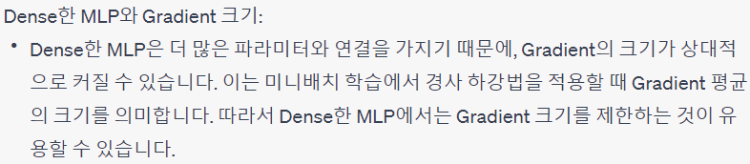
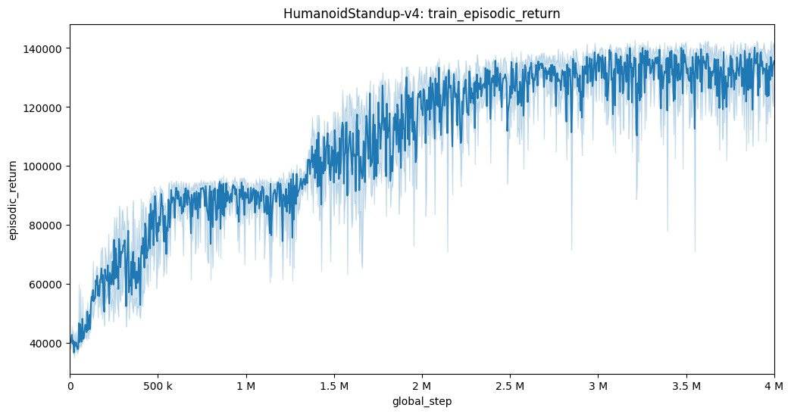
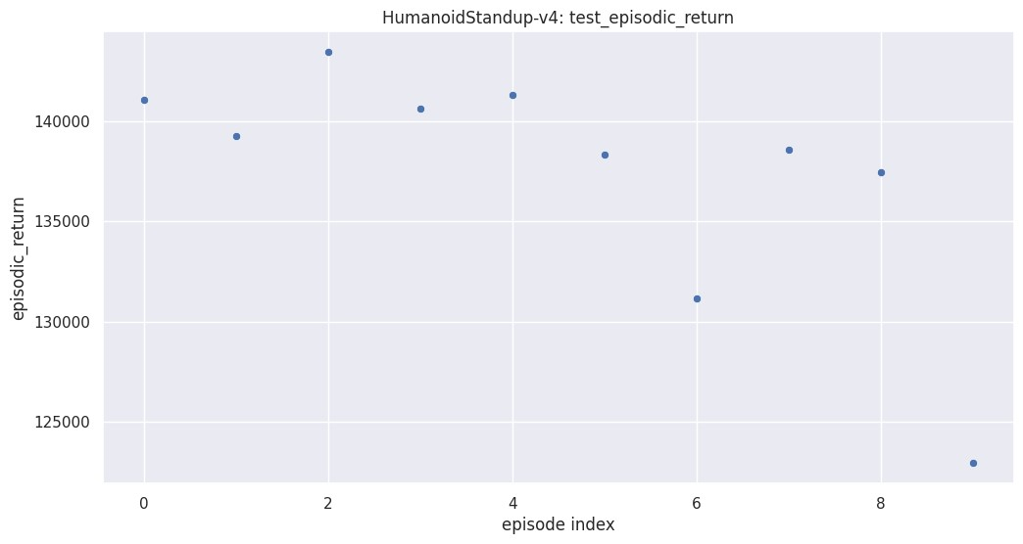
Experiments
Credit by ChatGPT
Performance 6 – Humanoid Standup
Average of 10 times evaluation: 137420.84
Difference: ent coef 0.001, max grad norm 0.5
Additional Architecture 2 (More layers, no hierarchy 128 – 128 – 128)
Notes:
After this, I used an additional architecture 2. And when I asked ChatGPT to set up a hyperparameter suitable for the new architecture, I was advised to reduce the size of gradient. In addition, for some randomness, I set the small entropy coefficient. So, the performance improved and the learning curve became very stable.

Slide 25
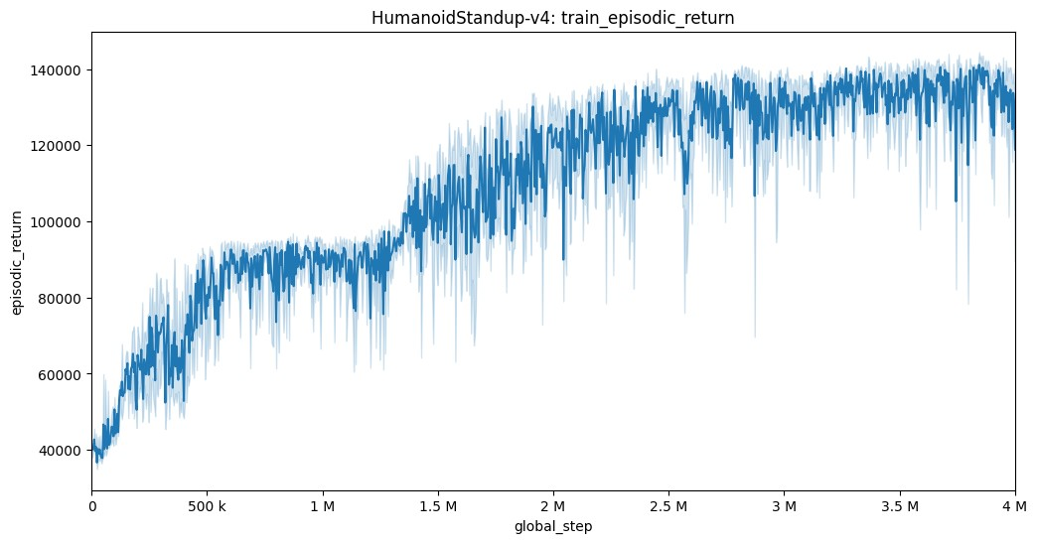
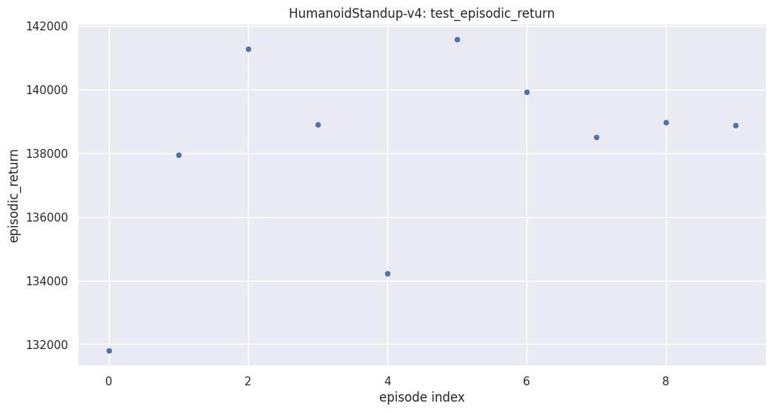
Experiments
Performance 7 – Humanoid Standup
Average of 10 times evaluation: 138200.6
Difference: Learning rate annealing lrnow if lrnow > 1e-5 else 1e-5
Notes:
I also tried a new method to limit learning rate annealing, and there was some performance improvement.

Slide 26
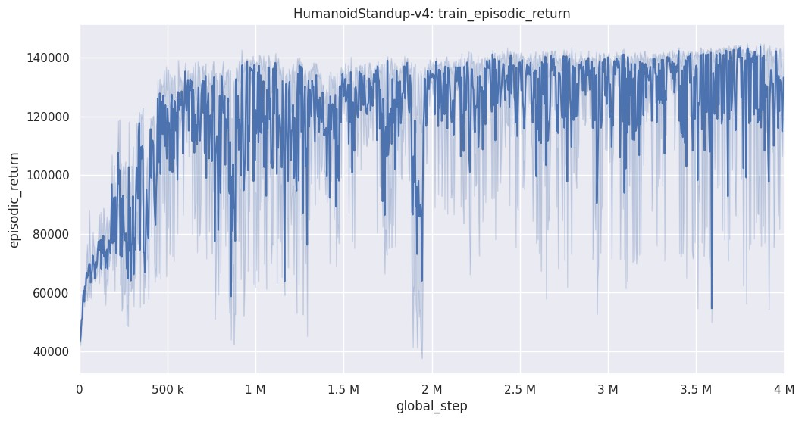
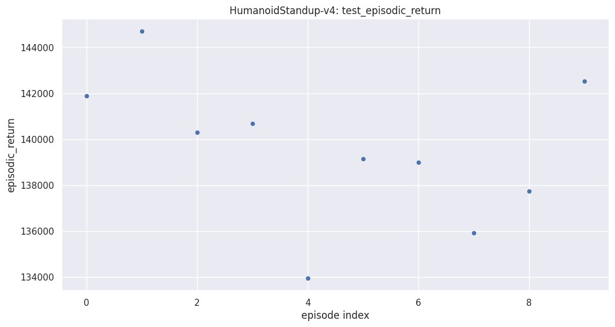
Experiments
Performance 8 – Humanoid Standup (Final Model)
Average of 10 times evaluation: 139583.1
Difference: Additional Architecture 3 (Much more, hierarchical layers 256 – 128 – 64 – 32)
Notes:
With all the previous techniques applied, I made architecture larger, and there was a performance improvement. And I decided on this as the final model.

Slide 27
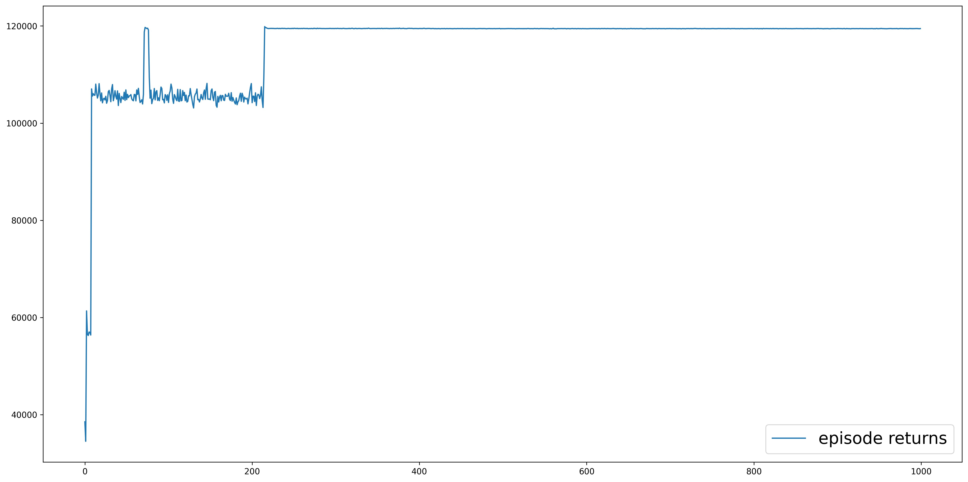
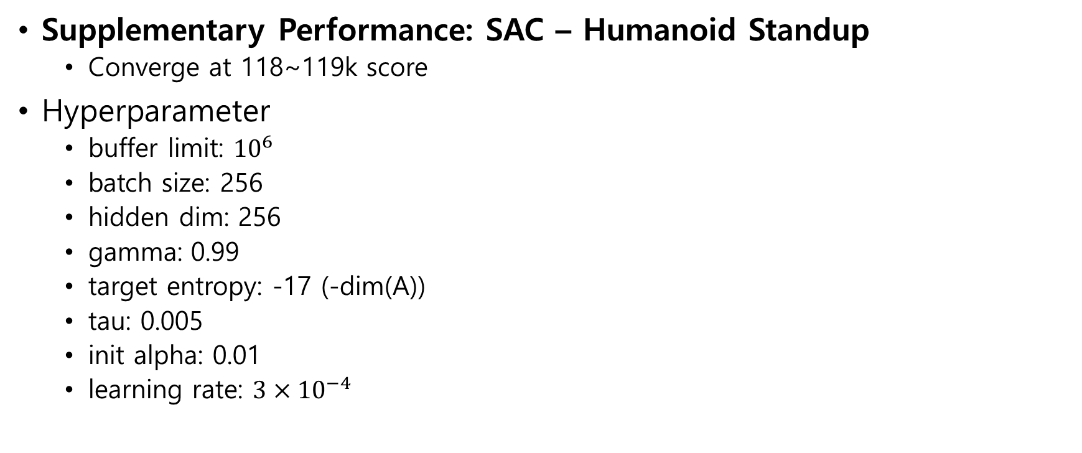
Experiments
Supplementary Performance: SAC – Humanoid Standup
Converge at 118~119k score
Hyperparameter
buffer limit: ${10}^{6}$
batch size: 256
hidden dim: 256
gamma: 0.99
target entropy: -17 (-dim(A))
tau: 0.005
init alpha: 0.01
learning rate: $3×{10}^{−4}$
Notes:
It is a supplementary result. Without going through hyperparameter tuning and I only brought this from SAC paper. It showed good performance and stability.

Slide 28
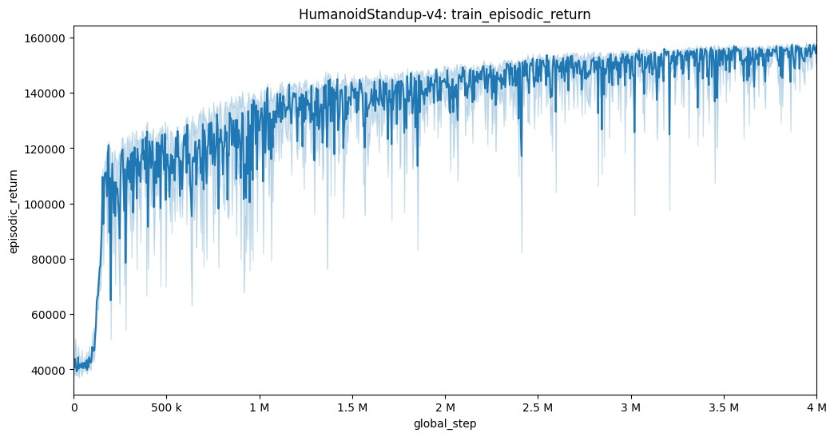
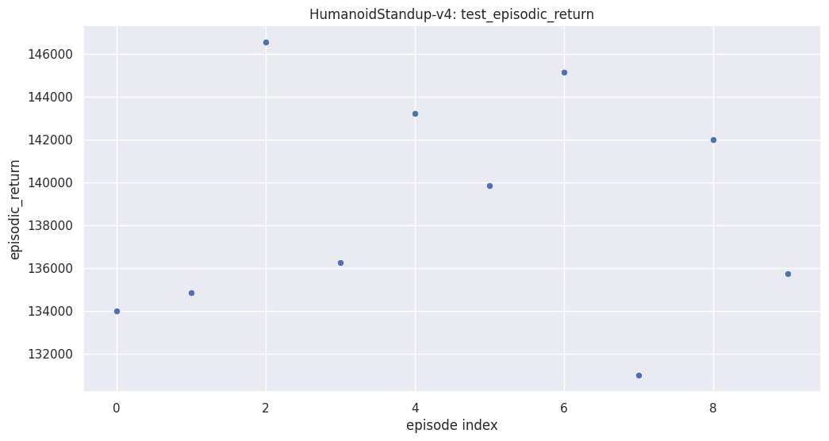
Experiments
Supplementary Performance: Overfitting 1 – Humanoid Standup
Average of 10 times evaluation: 138852.17 – checkpoint of 50% trained model
Flatten observation, Clip action, Normalize observation, Transform observation
One of Training Performance: episodic_return=[158386.48]
Notes:
As I mentioned in the method section, I used wrappers. But the model is overfitted.

Slide 29
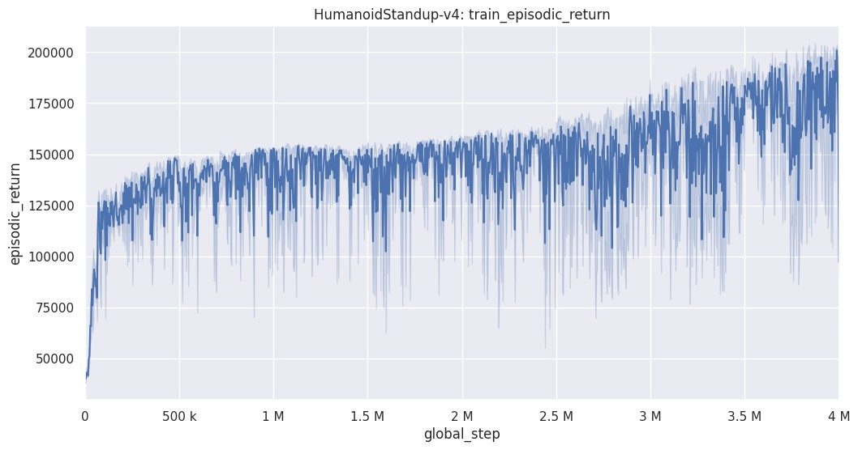
Experiments
Supplementary Performance: Overfitting 2 – Humanoid Standup
Flatten observation, Clip action, Normalize observation, Transform observation
+ Normalize reward, Transform reward (Is it valid?)
Training reward reached +210,000
Notes:
And I don't know that it's a valid method, but when I used the reward wrapping methods, it showed an incredibly high training performance, but the testing performance was less than half.

Slide 30

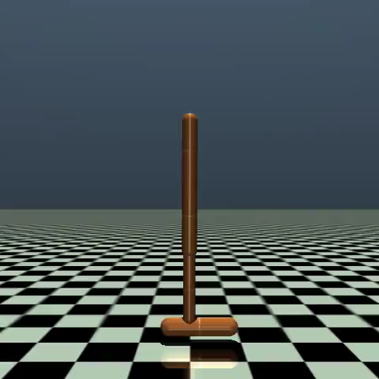
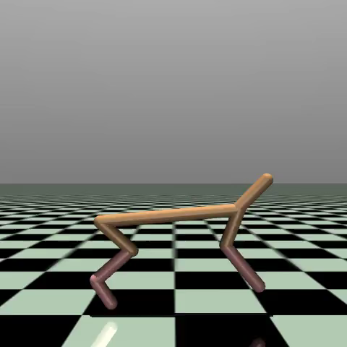
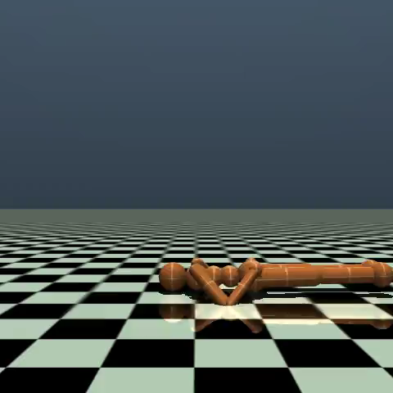
Experiments
Pendulum: -0.355
Hopper: 2959.9116
Half Cheetah: 4614.538
Humanoid Standup: 142725.08
Notes:
These are testing videos.

Slide 31
Conclusion
Analysis of the experiments
The most important thing is learning rate.
PPO: Improve stability and sample efficient (reuse of mini-batches)
Although performance can depend heavily on the initial state of the environment, the stability of the PPO has allowed us to obtain results that are not significantly different in several experiments.
Summary of the training procedure and results
More layers, hierarchical architecture
To know the effects of hyperparameters, you must not change multiple hyperparameters at once.
If there are unsuitable parameters and too many techniques are applied, there is a high possibility of overfitting.
Notes:
That's the conclusion. To sum up in one sentence, I tried many variants and tunings, but the most important thing was the learning rate. That’s it. Thank you for listening.

